Slide 1

Agentic AI Self Healing
Introduction
Agentic AI Defined AI systems that act as autonomous agents, capable of decision-making and executing tasks without constant human oversight. Why Self-Healing Matters IT environments are increasingly complex and distributed. Traditional reactive approaches lead to downtime and inefficiency. Businesses need proactive, autonomous solutions to maintain continuity.
Business Context/Problem Statement
Frequent vm down/Filesystem full/Pod failure Frequent service disruptions due to config/resource issues Slow detection & manual fixes → high MTTR SLA breaches risk customer trust & penalties
Solution
AI agents monitor observability data & perform RCA Triggers self‑healing actions; escalates via Slack Fully audit‑logged for process compliance
How Agentic AI enable Self Healing
Autonomous Monitoring Continuous alert checks across servers, networks, and applications. Predictive Analytics LLM models analyze the logs and propose the solution. Automated Remediation Executes corrective actions instantly— restarting services, reallocating resources. Learning Loop Improves with every incident, creating a knowledge base for future prevention.Platform: OpenShift
Current Challenge
Complexity Explosion Multi-cloud, hybrid setups, microservices, and containerized workloads. Manual Intervention Issues Delayed incident resolution. Increased operational costs. Higher risk of human error. Impact on Business Downtime costs millions. Customer experience suffers. Process Compliance risks increase.
Tech Stack
Platform: OpenShift Observability: Prometheus, Grafana, Loki LLM: Llama3, OpenAi Remediation: Kubernetes Packages Integrations: Slack, Teams, Alertmanager Knowledge Base: Vector DB
Benefits
Reduced Downtime Near-zero recovery time for critical systems. Cost Efficiency Lower operational overhead and fewer manual interventions. Scalability Handles growing complexity without additional manpower. Improved User Experience Minimal disruptions for end-users and customers.

Slide 2
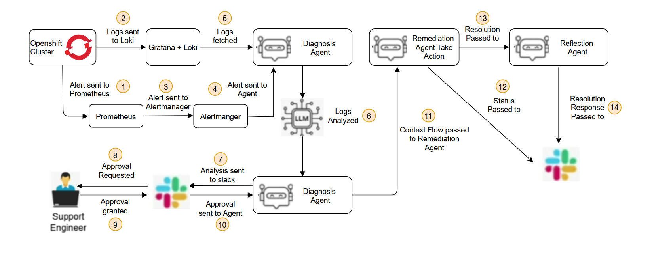
Agentic AI Self Healing
Architecture and Workflow

